Slide 1



The first Hub for Developers
HTML/CSS

Slide 2


Content
HTML
CSS
Bootstrap
Bundles
MVC and bootstrap
Tools

Slide 3
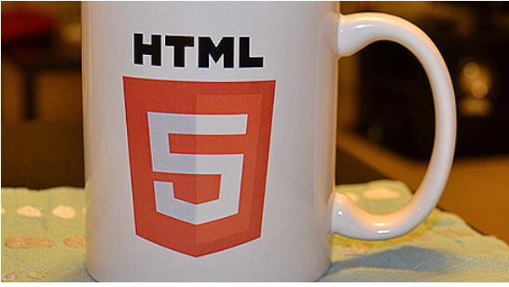
HTML
HTML stands for Hyper Text Markup Language
HTML describes the structure of Web pages using markup
HTML elements are the building blocks of HTML pages
HTML elements are represented by tags
HTML tags label pieces of content such as "heading", "paragraph", "table", and so on
Browsers do not display the HTML tags, but use them to render the content of the page

Slide 4
HTML
<!DOCTYPE html> <html> <head> <title>Page Title</title> </head> <body> <h1>My First Heading</h1> <p>My first paragraph.</p> </body> </html>

Slide 5
Basic elements
Paragraph
Headlines
Links
Image
Buttons
List

Slide 6
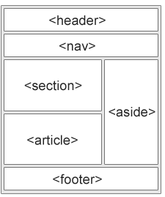
HTML layout
<header> - Defines a header for a document or a section
<nav> - Defines a container for navigation links
<section> - Defines a section in a document
<article> - Defines an independent self-contained article
<aside> - Defines content aside from the content (like a sidebar)
<footer> - Defines a footer for a document or a section
<details> - Defines additional details
<summary> - Defines a heading for the <details> element

Slide 7
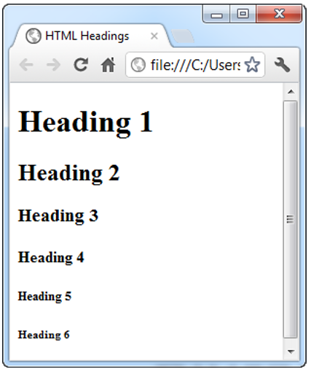
HTML Texting
Heading
H1 Primary head (used from search engines)
H2-H6 – sub heading
P for paragraph
BR Explicit line break
Hr horizontal rule
Character entities : &nbsp;,&lt;,&gt;
Sup & sub,Code,kbd

Slide 8
HTML – Block vs inline elements
<div>Hello</div> <div>World</div>
<span>Hello</span> <span>World</span>

Slide 9
HTML – Semantic vs non-semantic elements
<div>Hello</div> vs
<article>Hello</article>

Slide 10
HTML – lists
<ul style="list-style-type:square;"> <li>Coffee</li> <li>Tea</li> </ul>
<ol> <li>Coffee</li> <li>Tea</li> </ol>
<dl> <dt>Coffee</dt> <dd>- black hot drink</dd> <dt>Milk</dt> </dl>

Slide 11
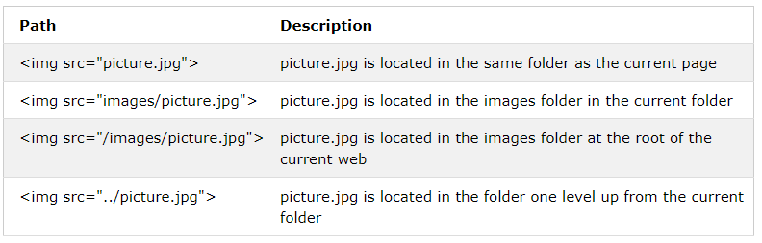
HTML images
<img src="img_chania.jpg" alt="Flowers in Chania">

Slide 12
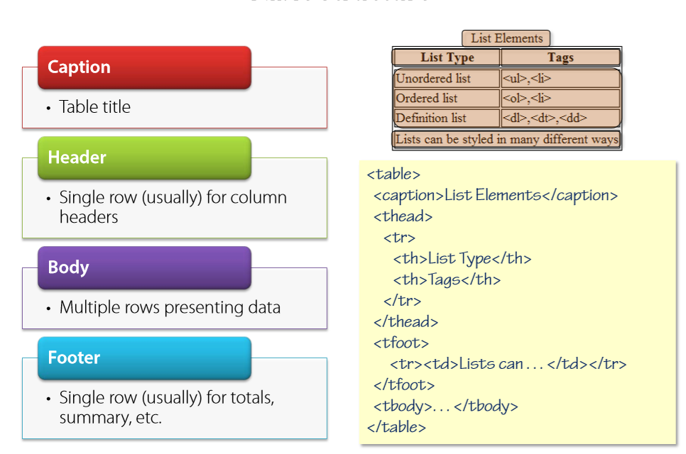
HTML tables

Slide 13
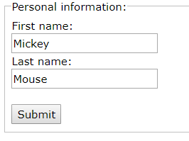
HTML forms
<form action="/action_page.php"> <fieldset> <legend>Personal information:</legend> First name:<br> <input type="text" name="firstname" value="Mickey"><br> Last name:<br> <input type="text" name="lastname" value="Mouse"><br><br> <input type="submit" value="Submit"> </fieldset> </form>

Slide 14
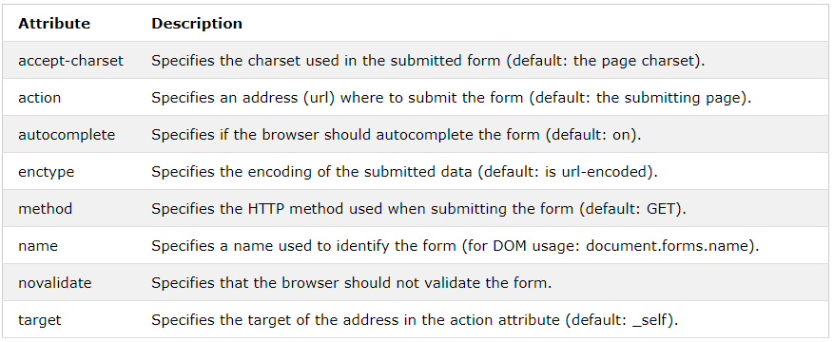
HTML forms
Form attributes

Slide 15
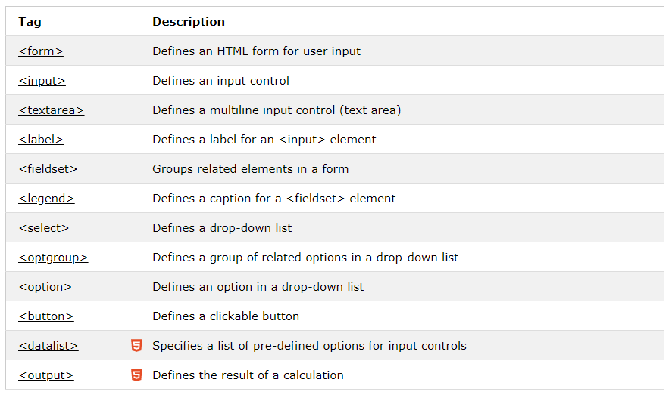
HTML Forms
Types

Slide 16
HTML Forms
<input type="button">
<input type="checkbox">
<input type="color">
<input type="date">
<input type="datetime-local">
<input type="email">
<input type="file">
<input type="hidden">
<input type="image">
<input type="month">
<input type="number">
<input type="password">
<input type="radio">
<input type="range">
<input type="reset">
<input type="search">
<input type="submit">
<input type="tel">
<input type="text">
<input type="time">
<input type="url">
<input type="week">

Slide 17
Input attributes
autocomplete
autofocus
height and width
list
min and max
multiple
pattern (regexp)
placeholder
required

Slide 18
HTML Media
<video width="320" height="240" controls> <source src="movie.mp4" type="video/mp4"> <source src="movie.ogg" type="video/ogg"> Your browser does not support the video tag. </video>
<audio controls> <source src="horse.ogg" type="audio/ogg"> <source src="horse.mp3" type="audio/mpeg"> Your browser does not support the audio element. </audio>
Youtube
<iframe width="420" height="315" src="https://www.youtube.com/embed/tgbNymZ7vqY"> </iframe>

Slide 19
HTML Graphics
CANVAS
<canvas id="myCanvas" width="200" height="100"></canvas>
SVG
<svg width="100" height="100"> <circle cx="50" cy="50" r="40" stroke="green" stroke-width="4" fill="yellow" /> </svg>

Slide 20
HTML api’s
Geolocation
Drag n Drop
Clipboard
Web workers
Web storage

Slide 21
HTML Misc
Paths
Head & meta tags
Iframes
Charsets
UrlEncode

Slide 22


CSS

Slide 23
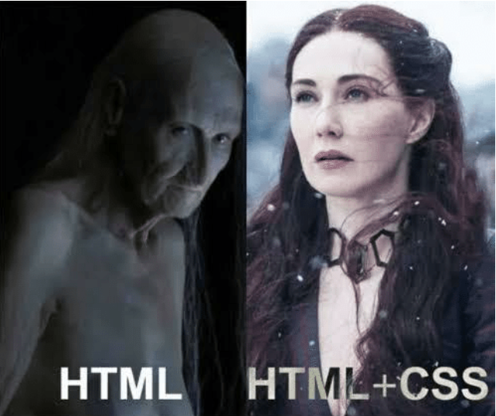
Adding CSS to HTML
Inline styles
<style> tag
Style files

Slide 24
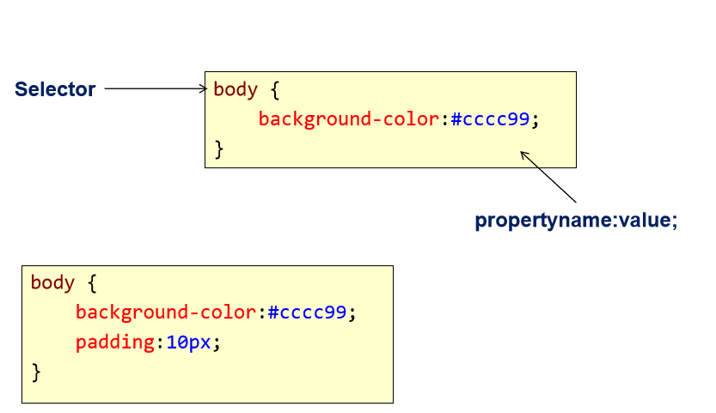
Rules
A selector is a pattern used to apply styles to elements

Slide 25
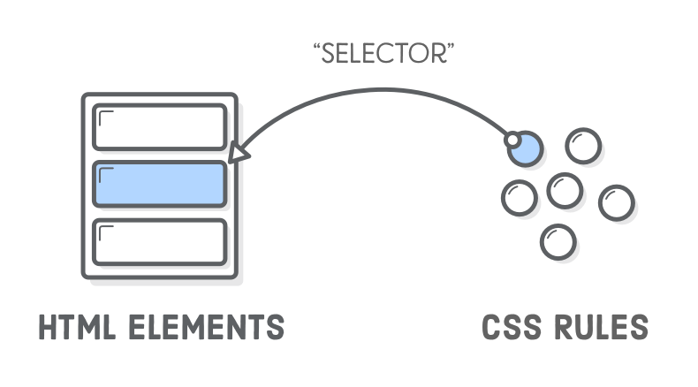
Selectors
Element Selectors p, div
Class selectors .myclass
Id selectors #myelement
Order matters

Slide 26
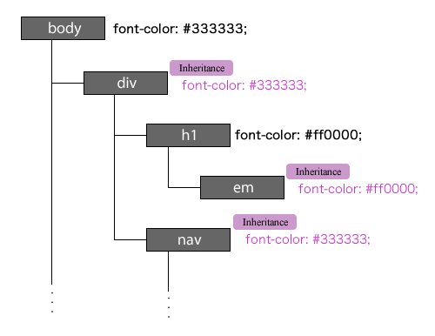
Inheritence
Some values are inherited by the children of an element in the document tree:

Slide 27
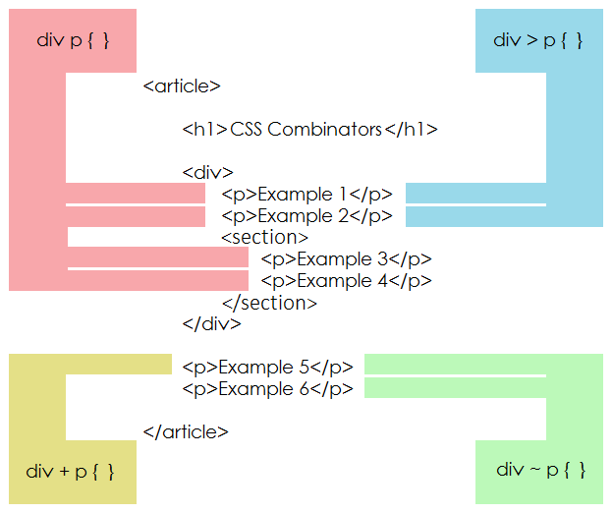
Combinators
A combinator is something that explains the relationship between the selectors.
A CSS selector can contain more than one simple selector. Between the simple selectors, we can include a combinator.
There are four different combinators in CSS:
descendant selector (space)
child selector (>)
adjacent sibling selector (+)
general sibling selector (~)

Slide 28
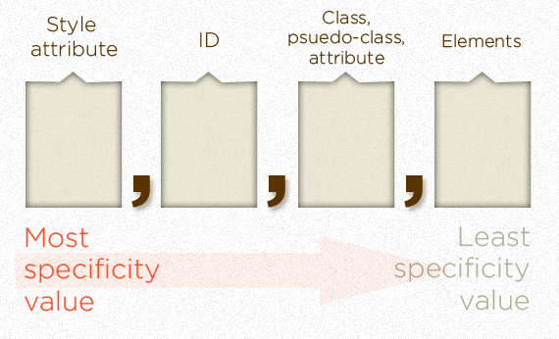
Specificity
If there are two or more conflicting CSS rules that point to the same element, the browser follows some rules to determine which one is most specific and therefore wins out.

Slide 29
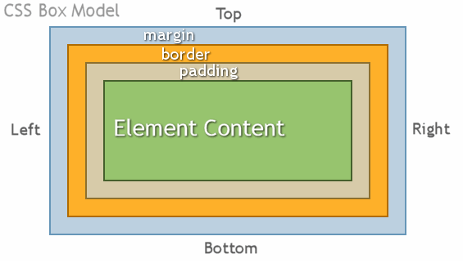
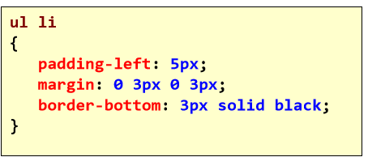
Box model

Slide 30
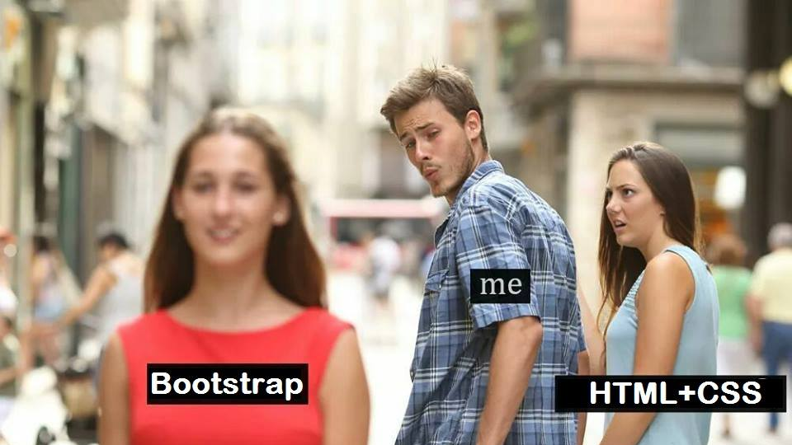
Bootstrap

Slide 31
Bootstrap
The most popular front-end framework for developing responsive, mobile first projects on the web.

Slide 32
Why use it?
CSS is hard
Cross Browser
Solves basic tasks (e.g. getting tables right)
Bootstrap 3 makes it easier

Slide 33
Bootstrap Features
Theme Support
Responsive
Grid
Components
Pagination
Buttons
Modal
Great Visual Studio support

Slide 34
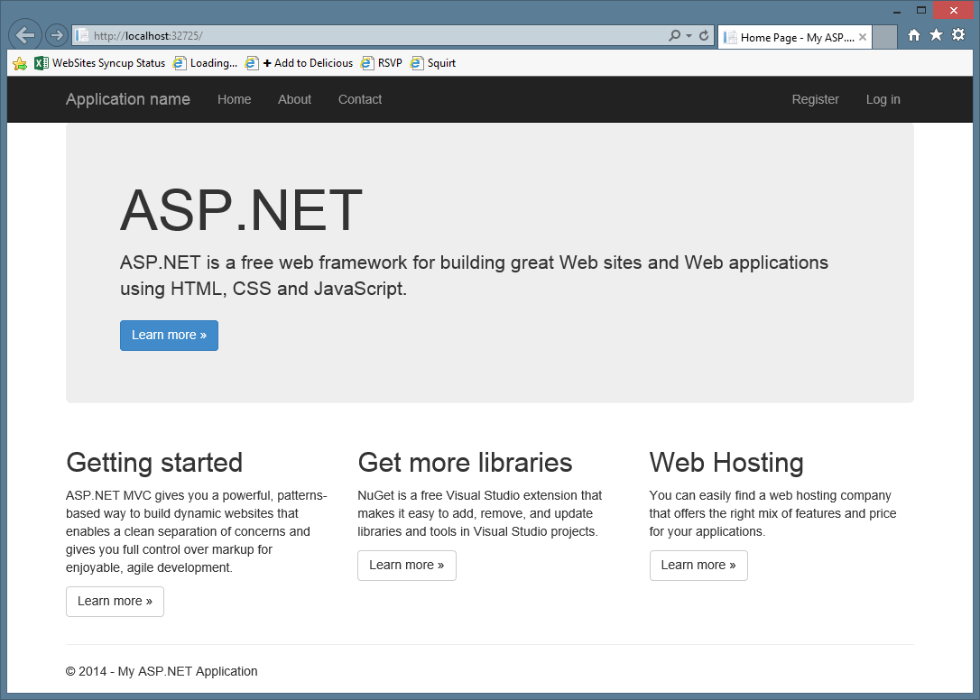

Slide 35
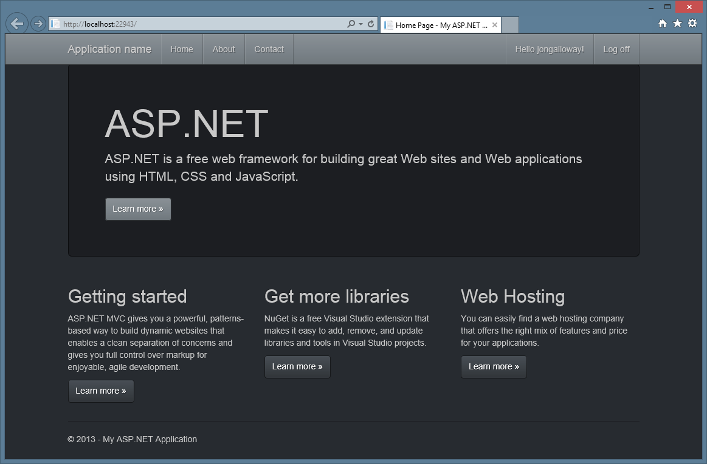

Slide 36
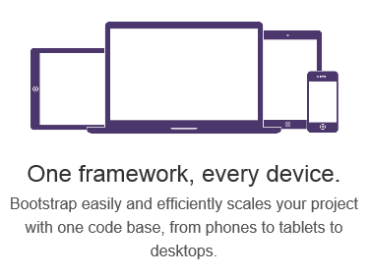
Responsive Layout

Slide 37
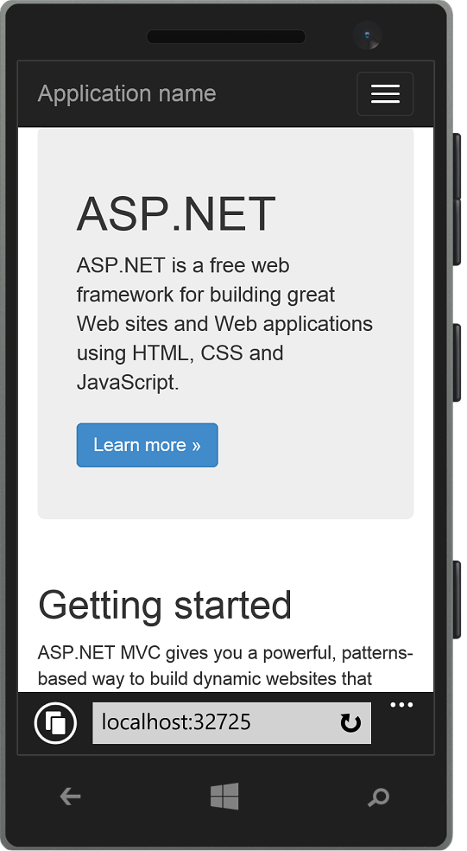
Responsive Layout

Slide 38
Grid system
 | Extra small devices Phones (<768px) | Small devices Tablets (≥768px) | Medium devices Desktops (≥992px) | Large devices Desktops (≥1200px)
Grid behavior | Horizontal at all times | Collapsed to start, horizontal above breakpoints
Container width | None (auto) | 750px | 970px | 1170px
Class prefix | .col-xs- | .col-sm- | .col-md- | .col-lg-
# of columns | 12
Column width | Auto | 60px | 78px | 95px
Gutter width | 30px (15px on each side of a column)

Slide 39
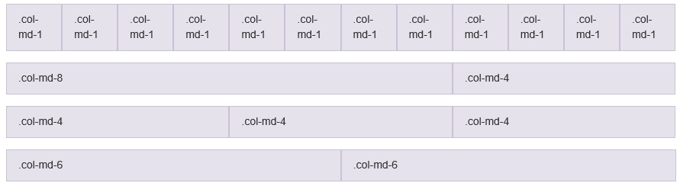
Grid system

Slide 40





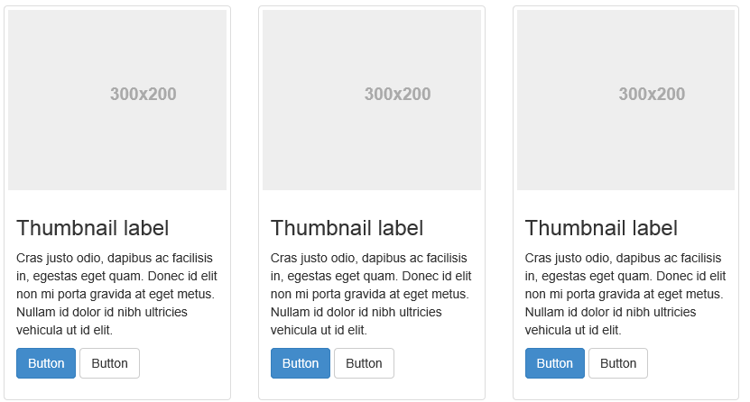
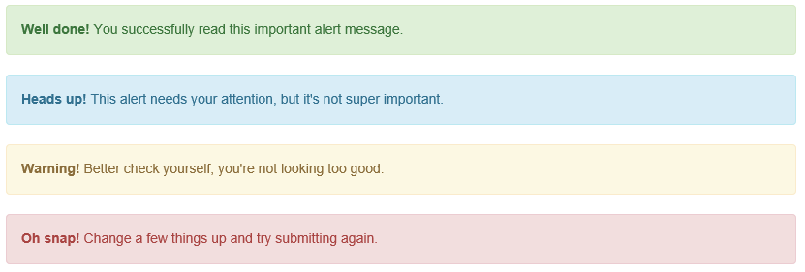
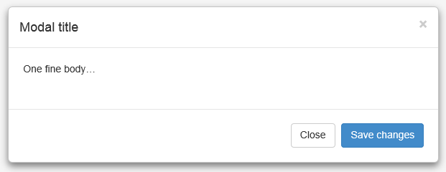
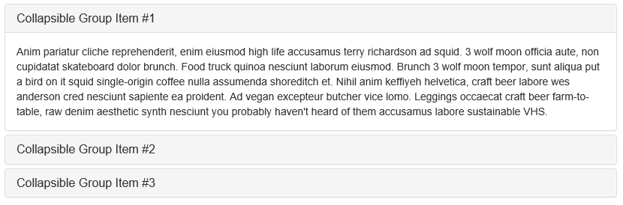
Components

Slide 41
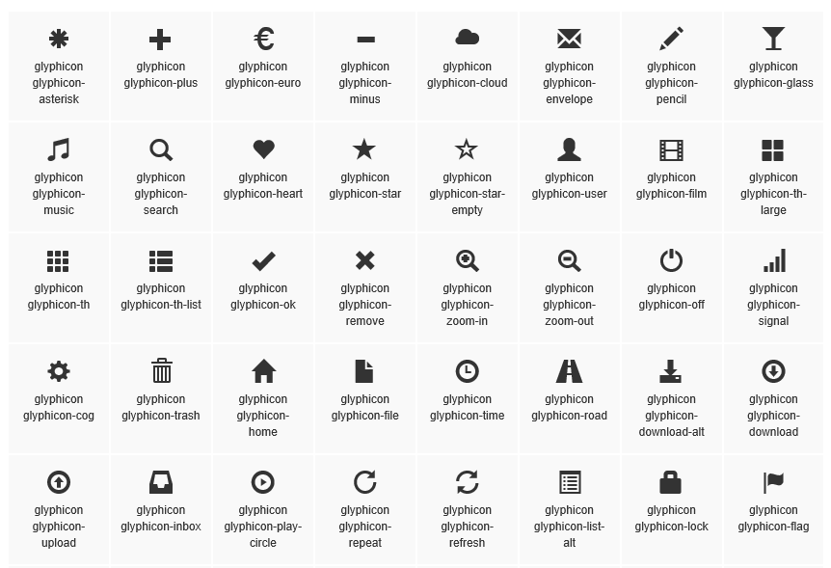
Glyphicons

Slide 42
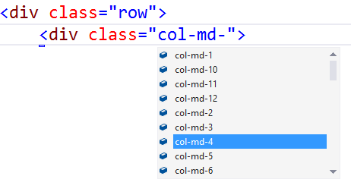
Visual Studio – Class IntelliSense

Slide 43
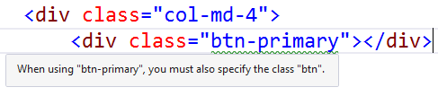
Visual Studio – Missing Class Detection

Slide 44
Tools
VS Code
Developer tools

Slide 45
References
https://www.w3schools.com/html/default.asp
https://www.w3schools.com/html/html_css.asp
https://www.w3schools.com/bootstrap/default.asp
https://bootswatch.com/
https://fonts.google.com
https://codepen.io/pen/
https://unsplash.com/
Mozilla Developer Network (MDN) is your friend
45 / 62

Slide 46

Thank You!

